Slide 1
Conversion of the Band Diagram Program
Michael Baker

Slide 2
What is an energy band diagram?
A method of displaying the electrical properties of a semiconductor.
Describes the ranges of energy an electron can have as it passes through the material.
Can be difficult and time consuming to create by hand, especially if there are a lot of dielectric layers.

Slide 3
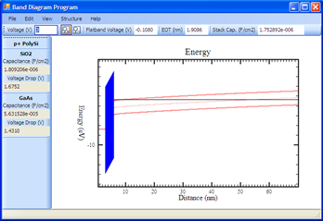
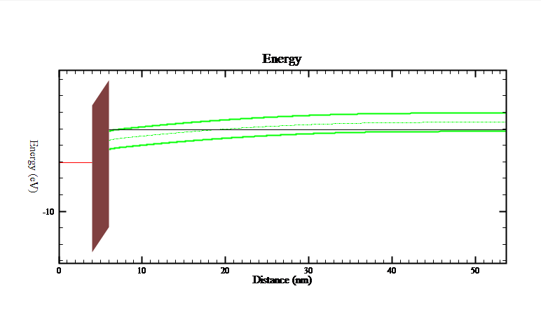
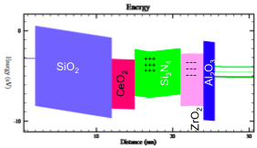
Band Diagram Program
Created by Richard Southwick III and William Knowlton.
Written in C# and released under the GPL2 license.
Supports
Static and animated diagrams.
Multiple dielectrics with optional fixed charges.
Calculates and exports many device parameters for further analysis.

Slide 4
Why change programming languages?
C# does not work well on Linux and Mac OS.
Crashes and lockups.
Slow and unofficial .NET framework development and support.
Unpredictable 3rd party tool behavior across platforms.
Portability is required by the industry
Many industry professionals want to use the software on Mac OS.

Slide 5
Project Scope
Convert the program to Java.
Java was designed with portability in mind and officially supports Windows, Linux and Mac OS.
BSU teaches Java programming in their CS curriculum, easier to find support for future development.
Many portable 3rd party tools available to enhance the software.

Slide 6
Project Scope (cont.)
Add additional chart functionality.
Normalize the user interface.
Attempt to improve processing times of various internal algorithms

Slide 7
Project Plan
Java code conversion
Explore automatic C# to Java conversion tools.
Use Subversion for version control to document development process.
Use NetBeans IDE for development.
Use Matisse Swing GUI Builder for visual design of forms.
Implement JavaDoc comments to create a “self documenting” architecture for the code.
Explore code obfuscation for initial release to help prevent reverse engineering or decompiling while paper on new features is being published.

Slide 8
Project Plan (cont.)
Add additional chart functionality
Use JFreeCharts for charting
Also released via GPL2.
Has many additional built in features
Lasso and Mouse Wheel Zooming
Panning
Annotations
Hover text
Drilldown
Easy to use and expand for custom charts.

Slide 9
Project Plan (cont.)
Normalize the user interface
Move Output Parameters to a separate form.
Add double click support to list views
Add consistent default functionality for OK and Cancel buttons.
Improve editing speed by defaulting frequently used fields like ‘thickness’.
Add stop option for animation.

Slide 10
Project Plan (cont.)
Attempt to improve processing times of various internal algorithms
Complex semiconductor designs can require long calculation times to display and animate.
Reduce processing times by condensing logic.
Use threads for calculations to keep the user interface responsive and allow cancelling.
Possibly use multiple threads to process calculations in batches.

Slide 11
Timeline
Spring 2010
Existing program and tool research
Form layout and basic connectivity
Advanced connectivity and internal material manipulation
Main and auxiliary charts and global options
Summer 2010
Complete charts and global options
Multi-platform Installer
Testing for initial release
GUI improvements and algorithm analysis
Testing for improved version release

Slide 12
Release Process
Direct Port (Band 3.0)
First release will be a direct port with minimal changes to GUI.
Enhanced Release (Band 3.1)
Larger GUI changes
Multi-threading and algorithm enhancements.
Added features from branch C# versions

Slide 13
Multi-platform Installer
Java Web Start
Requires Java Runtime to load.
Install or run software by clicking link on a webpage.
Once installed can run with or without internet connection.
If internet connection available, JWS can automatically check for a newer version and update.

Slide 14
Possible Future Enhancements
3D charts
Multi-chart display
Save animation to standard movie formats.
Drag and Drop structure creation.
Open XML based configuration and data formats.
GPU processing to increase calculation speed. (CUDA)
Integrated help system.
Applet application format to encourage use when downloading is not an option.

Slide 15
Questions?

